Slide 1
CAPSTONE PROJECT GRADED ASSIGNMENT MOBICOM
NEELAM AGARWAL
User ID: Jig11670

Slide 2
PROBLEM STATEMENT-1
What are the top five factors driving likelihood of churn at Mobicom?
PROBLEM FINDING
The top five driving factors for churn is
Demographic factor (Lower income group)
Cost and Billing (High Overage)
Network (Low Call Quality )
Service Quality (More no. of Complaints)
Call usage (Low total calls)

Slide 3
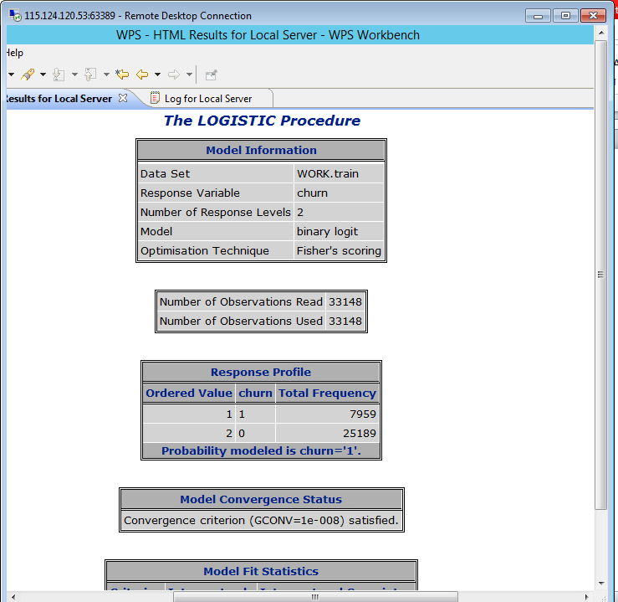
MODEL OUTPUT

Slide 4
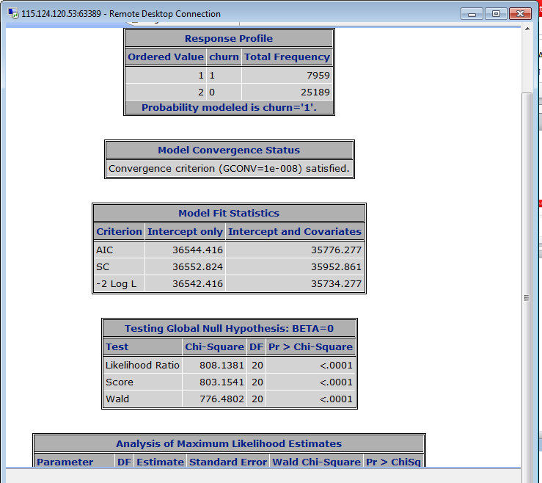
MODEL OUTPUT CONTINUED..

Slide 5
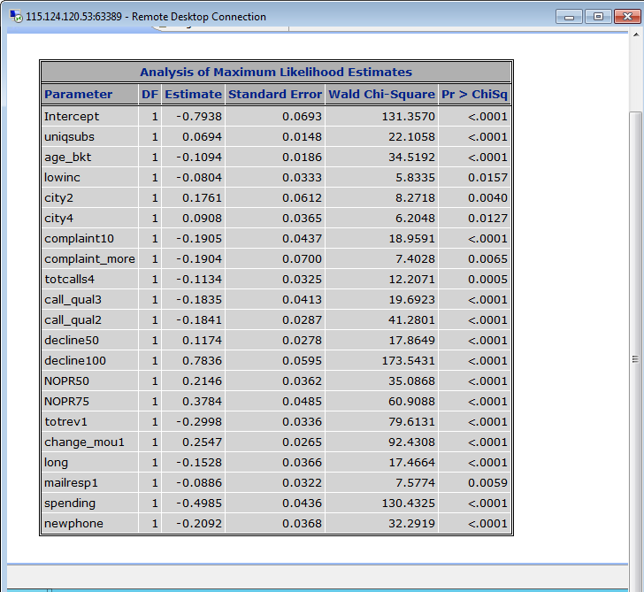
MODEL OUTPUT CONTINUED..

Slide 6
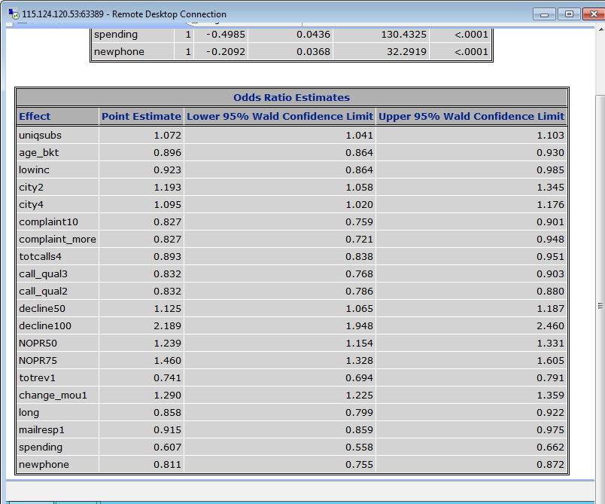
MODEL OUTPUT CONTINUED..

Slide 7
PROBLEM STATEMENT-2
a) Whether “cost and billing” and “network and service quality” are important factors influencing churn behaviour.
b) Are data usage connectivity issues turning out to be costly? In other words, is it leading to churn?

Slide 8
PROBLEM FINDING
Cost and Billing has effect on churn. From the model, I observed that people who have got their billing adjusted by more than 50% are likely to leave the network provider than other customers.
Coming to service quality, customers who have made more than 3 complaints are likely to effect churn rate.
While trying to get the data for connectivity, I have calculated the call quality as
quality call= Completed call/placed calls
And put them into buckets and run logistic model on the data.
(Have also used drop_blk_mean data from the data file)
From the above, I have observed that customers facing more connectivity issues are likely to leave the services.
Also, data usage connectivity issue has significant effect on churn.

Slide 9
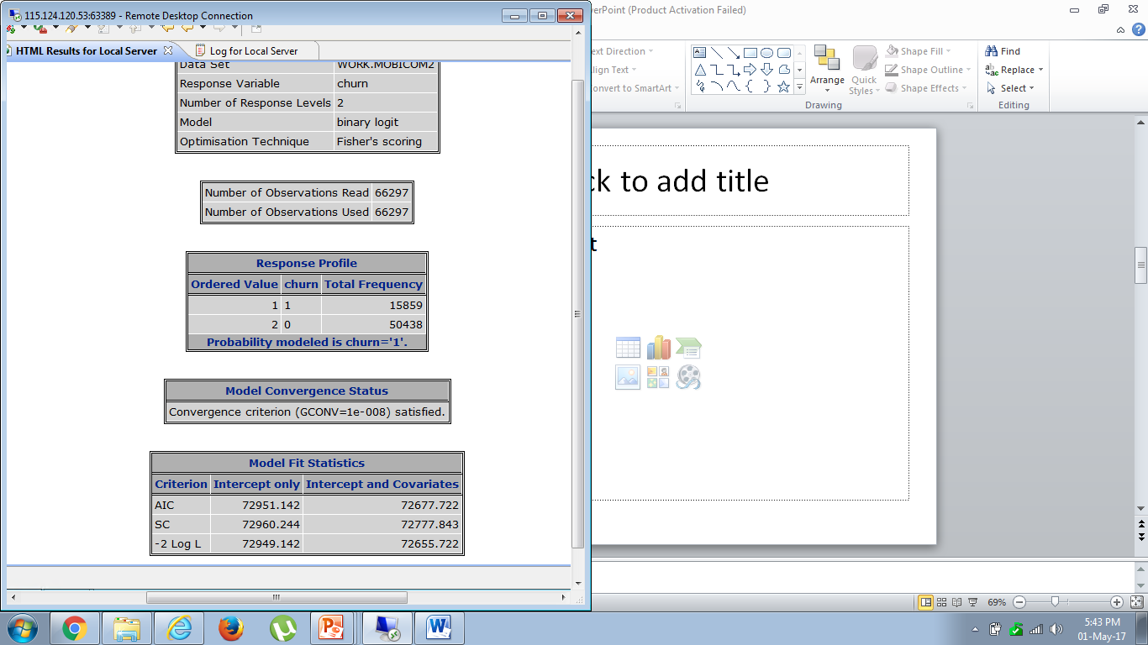
MODEL OUTPUT

Slide 10
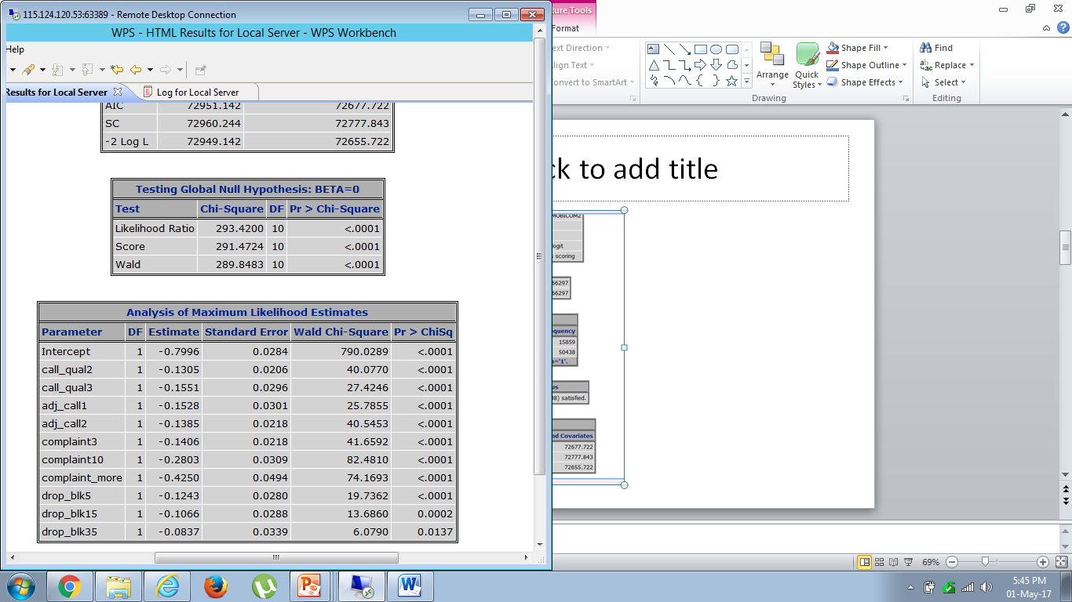
MODEL OUTPUT CONTINUED..

Slide 11
PROBLEM STATEMENT-3
Would you recommend rate plan migration as a proactive retention strategy?
After running the model on the data following points are observed.
Customers with more than 25% overage are likely to have effect on churn.
(This is calculated from data: overage revenue/total revenue)
Customers with more change in minutes of usage over past 3 months are likely to leave the service
Also Customers who are using more than 60% in Roaming are looking for better plan to suit their requirements.
I strongly recommend for RATE PLAN MIGRATION as a retention strategy

Slide 12
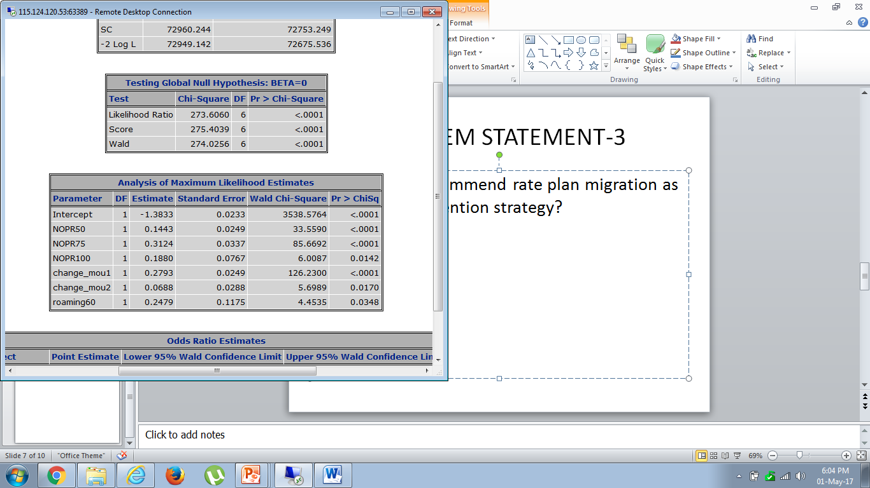
MODEL OUTPUT

Slide 13
PROBLEM STATEMENT-4
What would be your recommendation on how to use this churn model for prioritization of customers for a proactive retention campaigns in the future?
OBSERVATION:
There are 29.2% customers who responded to the mail (offers) and are still in the service. Out of 23.9% customers who left the service, 8.49% are the ones who responded to the mail and still left the service. It is observed that mail offers are having significant effect in retaining the customers.
Retaining the customers on reactive basis seem to have very less impact on retention with only 3-7% decrease in churn.

Slide 14
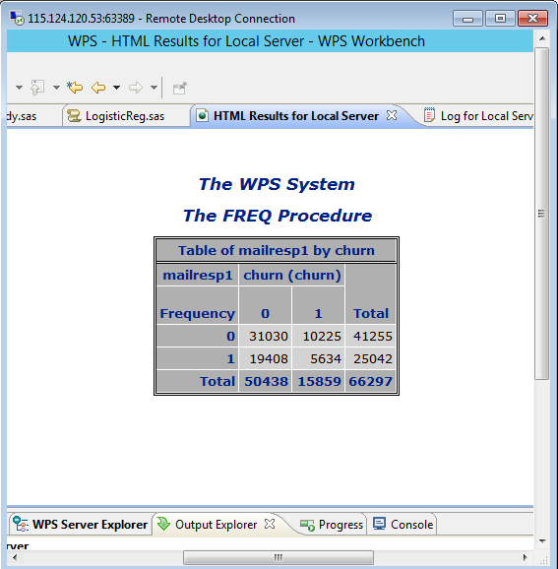
MODEL OUTPUT

Slide 15
PROBLEM STATEMENT-4 CONTD..
Prioritization of Customers: As we can see low and medium income group of customers are highly likely to switch to other favorable services than customers with high and very high income group. So by tapping on these customers by providing optimal rate plan can help in retention
Town(city2) and Rural(city4) customers can also be prioritized

Slide 16
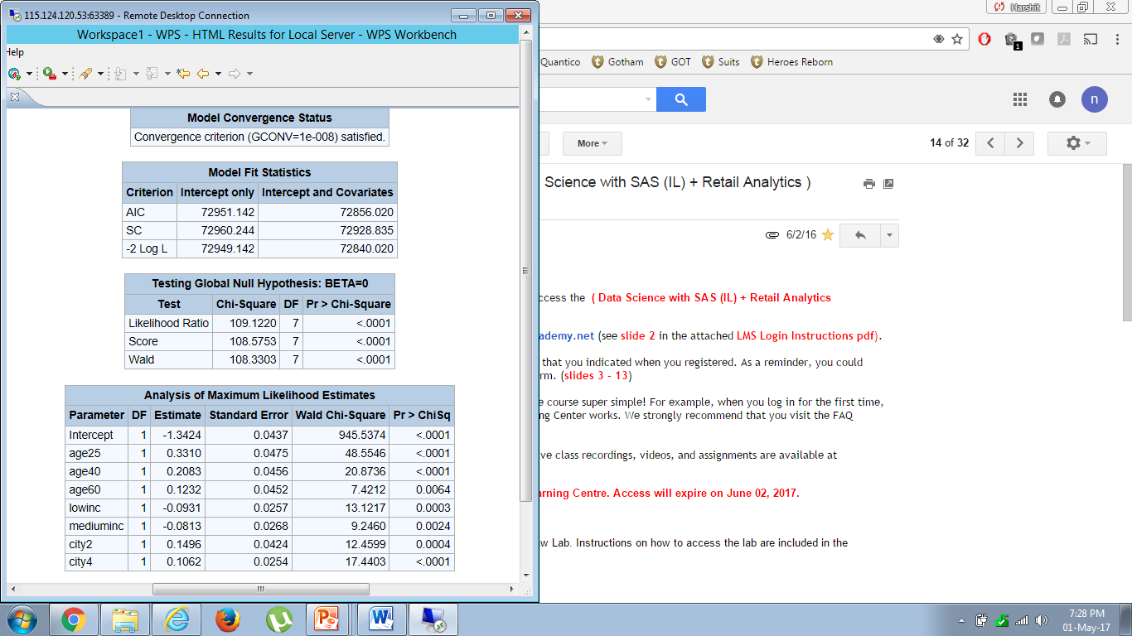
MODEL OUTPUT

Slide 17
PROBLEM STATEMENT - 5
What would be the target segments for proactive retention campaigns?
Falling ARPU forecast is also a concern and therefore, Mobicom would like to save their high revenue customers besides managing churn.
Given a budget constraint of a contact list of 20% of the subscriber pool, which subscribers should prioritized if “revenue saves” is also a priority besides controlling churn. In other words, controlling churn is the primary objective and revenue saves is the secondary objective.

Slide 18
PROBLEM FINDING
Target segment for retention program can be low income group and medium income group as these group of customers look out of better and optimal plans increasing churn rate.
23.4% of customers who have new phones go for other network providers. These customers can be targeted by offering bundling plans suitable to the customer.
Customers with age less than 40 can be targeted with retention strategies
Customers with more than 25% Overage can be the target segments as they are highly likely to be interested for better plans. This has to be done very carefully as this group of customers are also contributing towards high revenue.
Gender wise male can also be our target segment

Slide 19
PROBLEM FINDING CONTD..
Keeping revenue in mind, High income group and very high income group who contribute more towards high revenue can be retained without offering any optimal plan to avoid falling ARPU and total revenue.
Also by tapping on age group which is below 40 years, churn can be reduced with increase in ARPU.
One of the observation keeping in mind revenue saves for the company is, Customers with overage of more than 50% can be taken out from target rate plan migration if 25% churn is acceptable, as the revenue we get from these customers is more with churn rate equal to churn rate of customers with 25-50% overage.
High and very high income group can be migrated to a bigger plan for improving ARPU.

